Slide 1
QUIZVERSE
REVOLUTIONIZING EXAMINATION EXPERIENCE
GROUP NO. 13
PROJECT GUIDE : Asst Prof SREEDEEPA H S
PRESENTED BY,
ADR21CS032 JELAN MATHEW JAMES
ADR21CS059 SUJITH T S
ADR21CS034 JOEL SIBY VARGHESE
ADR21CS042 N HARIKRISHNAN
ADR21CS053 SABARINATH O

Slide 2
INDEX
INTRODUCTION
OBJECTIVES
SYSTEM DESIGN
DIAGRAMS
CURRENT PROGRESS
CONCLUSION

Slide 3
INTRODUCTION
A revolutionary web application transforming the examination experience.
QuizVerse aims to address the shortcomings of traditional examination methods by offering a versatile platform for conducting rigorous examinations and engaging quizzes.
Our presentation will explore the challenges faced by traditional examination methods and how QuizVerse provides innovative solutions to overcome them.

Slide 4
OBJECTIVES
QuizVerse is a web application designed to revolutionize the examination experience.
QuizVerse offers a versatile platform for conducting rigorous examinations and engaging, knowledge-testing quizzes.
Application contains Faculty console for conducting tests and analysis of student performance.
Student role users can attend viva and submit their answers. Community role users can create general quizzes that can be accesses by others.

Slide 5
QUIZVERSE SYSTEM DESIGN

Slide 6
Admin
Admins oversee system operations, managing Institution and Community Admins.
Institution Admin
. Institution Admins handle faculty assignments, student creation, and course management.
User Roles and Permissions
Community admin
Community Admins initiate community-based quizzes.
Faculty
Faculty members can conduct exams, create question sets, select students, and analyse performance
Student
Students participate in exams and review their individual performance

Slide 7
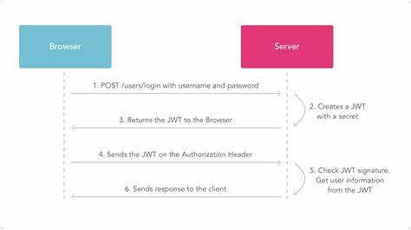
USER AUTHENTICATION – TOKEN BASED AUTHENTICATION
User registration is done by adding user details to database through api’s
User signin is done by providing email or username with password
TECHNOLOGIES USED
Token based authentication is implemented using JWT Technology
Basic Flow
User Schema:
id varchar(36)
username varchar(50)
email varchar(50)
password varchar(150)
is_verified tinyint(1)
created_at datetime(6)
updated_at datetime(6)
Login Schema:
username_or_email: str
password: str

Slide 8
DATABASE DESIGN

Slide 9
DIAGRAMS

Slide 10
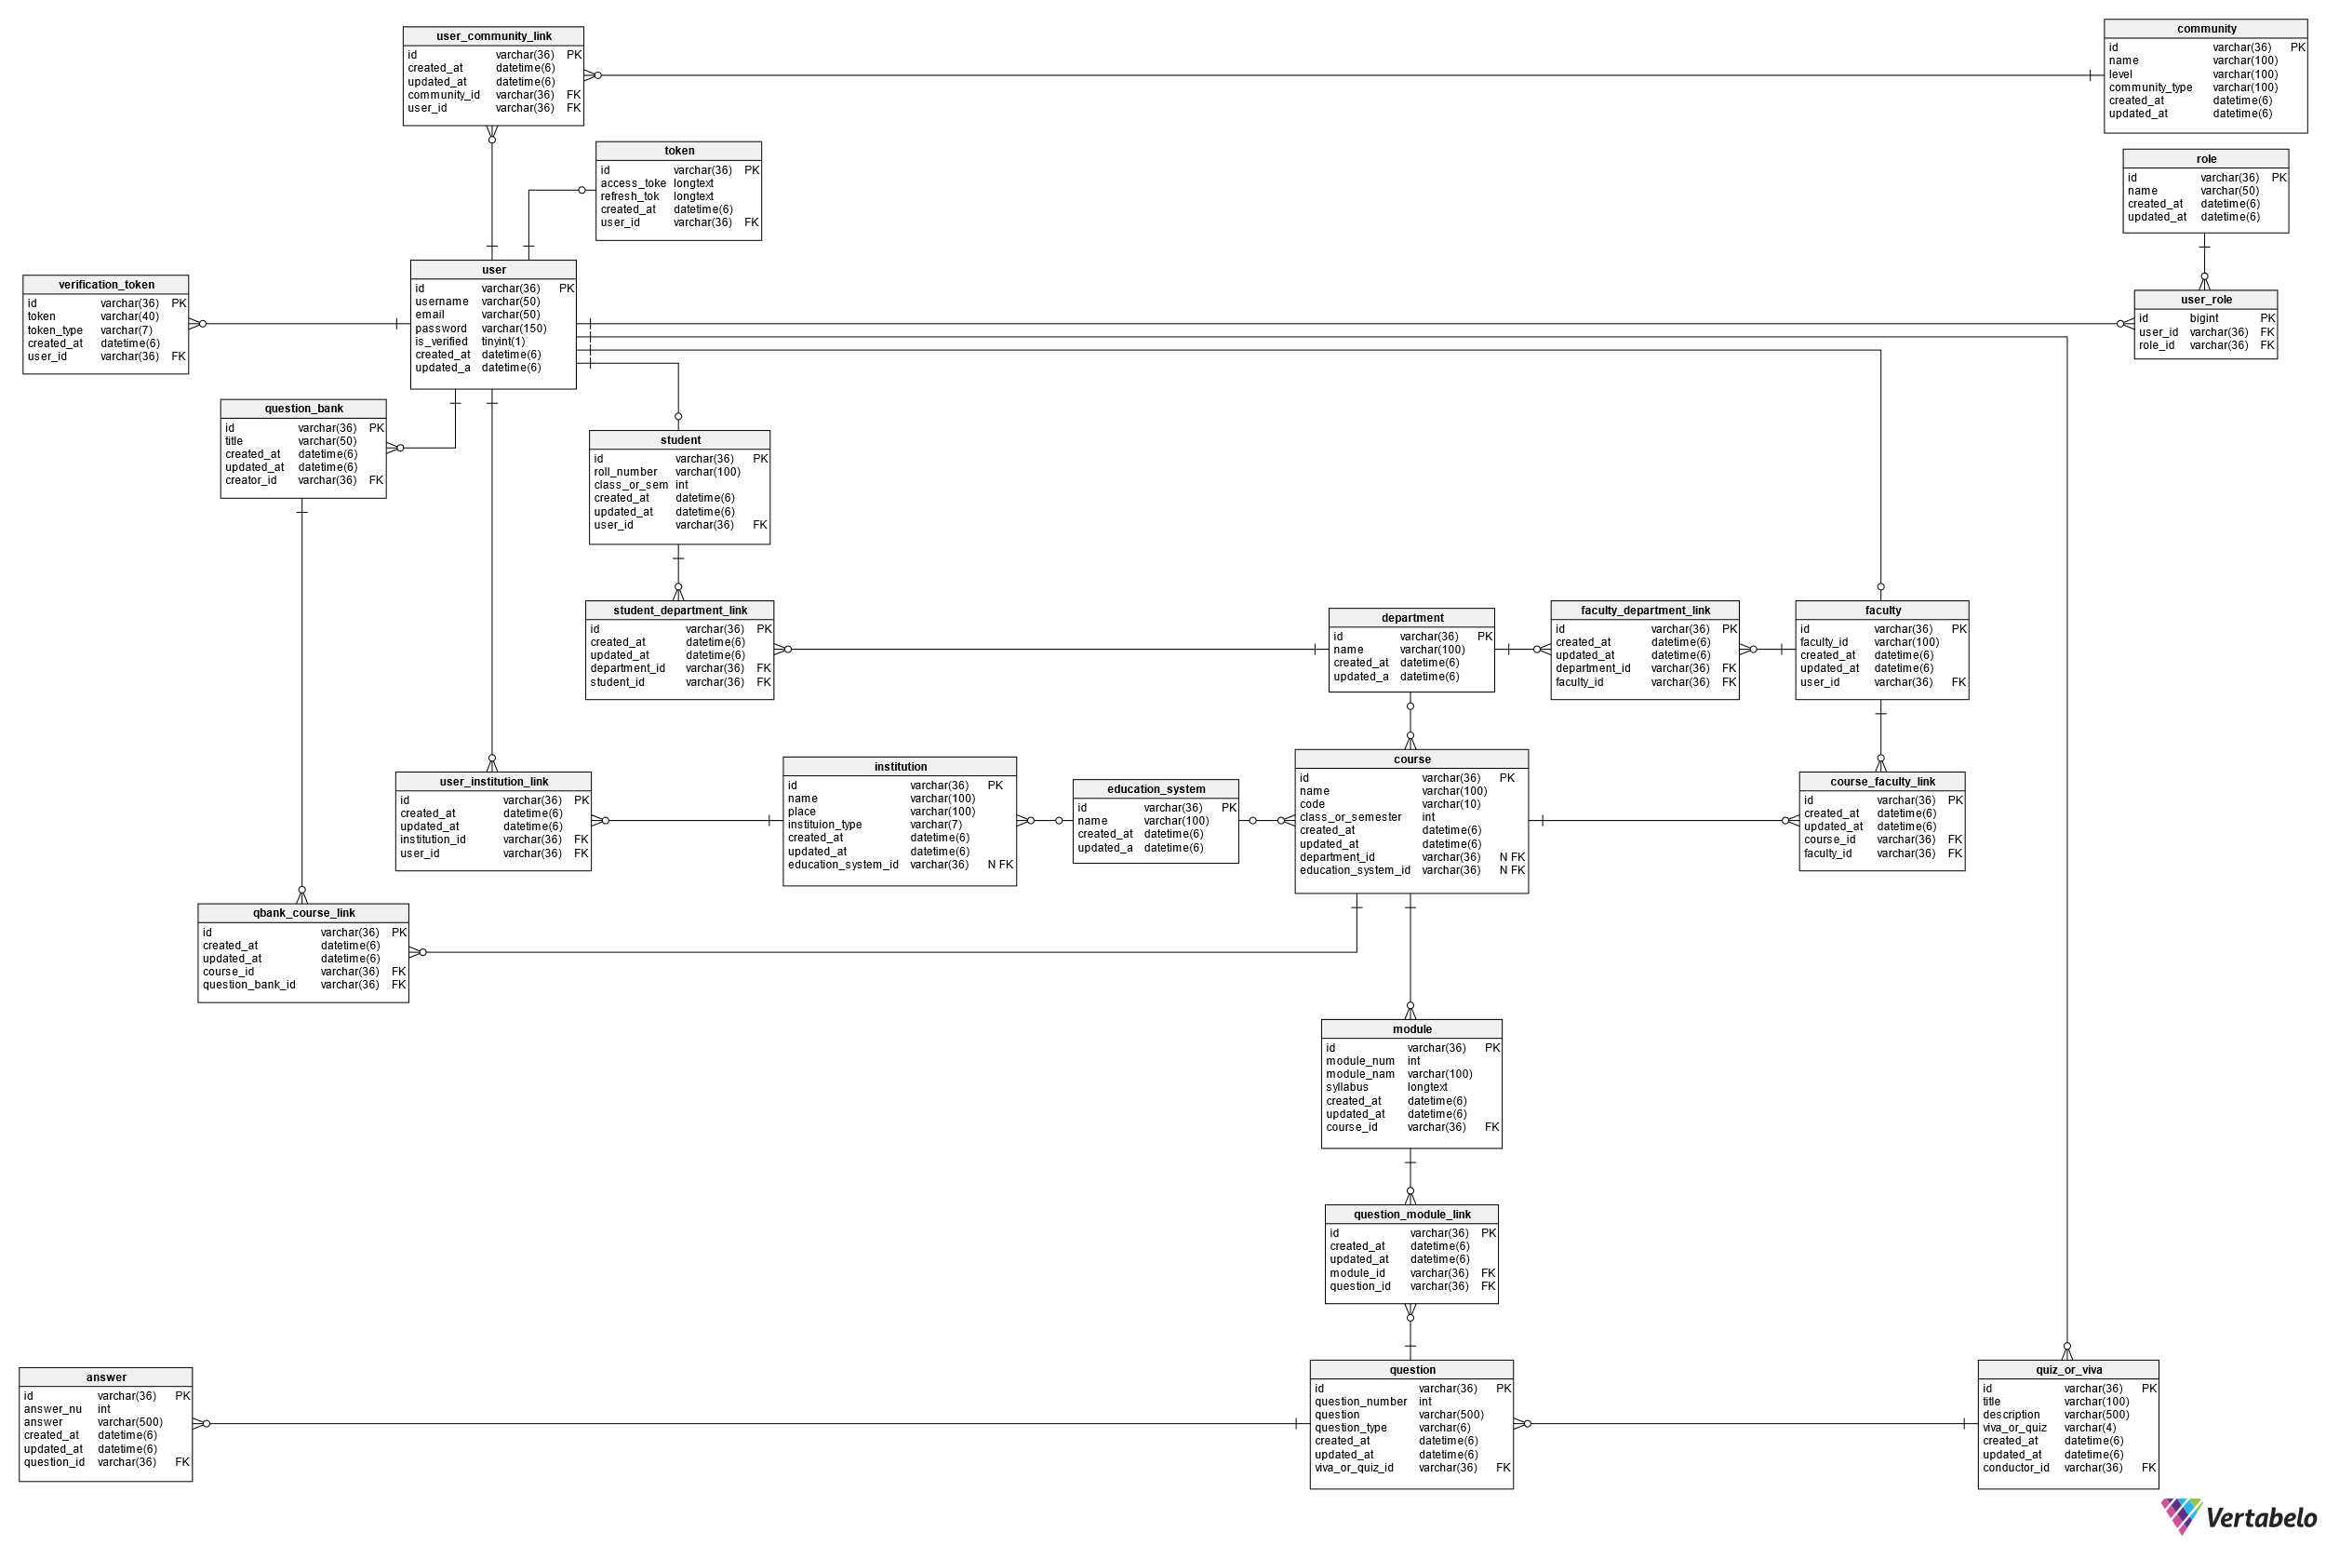

Slide 11
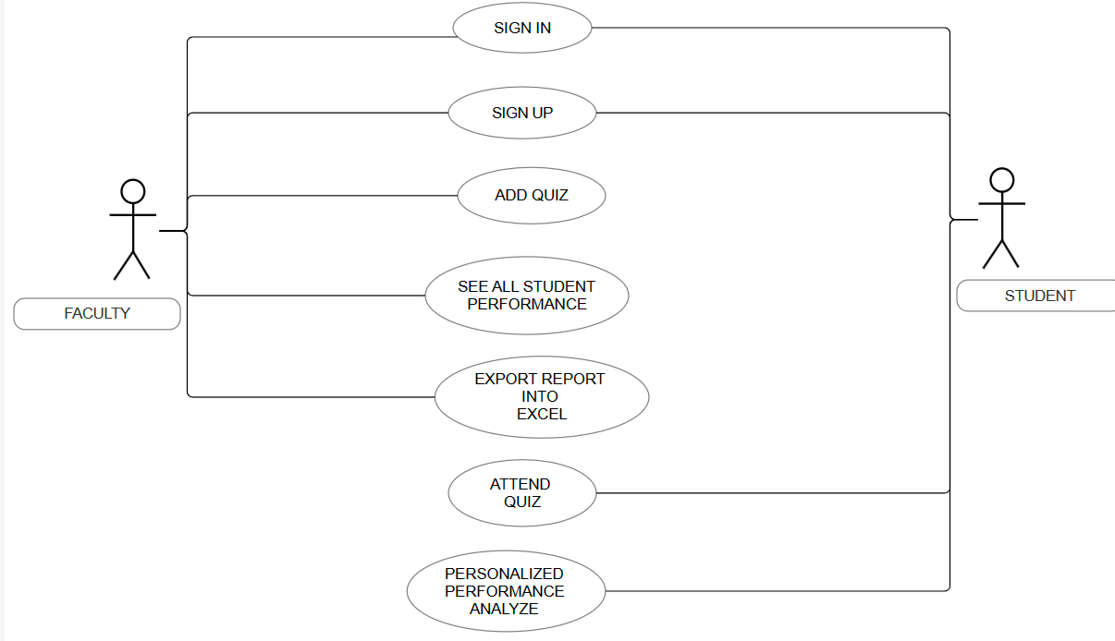
FACULTY – STUDEDNT USE CASE DIAGRAM

Slide 12
SOFTWARE AND HARDWARE
REQUIREMENTS
SOFTWARE REQUIREMENTS
OS: UBUNTU 22.04 LTS
API DEVELOPMENT: DJANGO NINJA
DATABASE: PostgreSQL
FRONT END: React
UI/UX: Figma
STYLING: Tailwind CSS
CLOUD PROVIDER: DigitalOcean
VERSION CONTROLLER: Git
CODE REPOSITORY: GitHub
HARDWARE REQUIREMENT
CPU: Basic Intel i3 1215u
GPU: Not required
RAM: 8GB
SSD: 240GB

Slide 13
CURRENT PROGRESS

Slide 14
In summary, QuizVerse offers a fresh approach to exams that tackles the problems with traditional methods. It makes tests easier for teachers and more enjoyable for students. With its user-friendly design and strong security features, QuizVerse provides valuable insights into how well students are doing. By embracing QuizVerse, we're moving towards a future where exams are smarter, easier, and more inclusive, helping everyone learn better.
CONCLUSION

Slide 15

THANKYOU

